Slide 1
A2: POV and Experience Prototypes
Kristine Ma, Carolyn Lee, Lucas Wang, Evelyn Song
CS147 ✳ Fall 2024

Slide 2
Table of contents
01
02
03
04
05
06
Introduction
POVs + HMWs
Additional
Interviews
Team intros and project domain
Interviewee profiles + additional learnings
Initial POVs, selected POVs, and generating HMWs
Solutions
Conclusions
Experience
Prototyping
Developing and selecting our top 3 solutions
What’s next?
Testing key assumptions

Slide 3
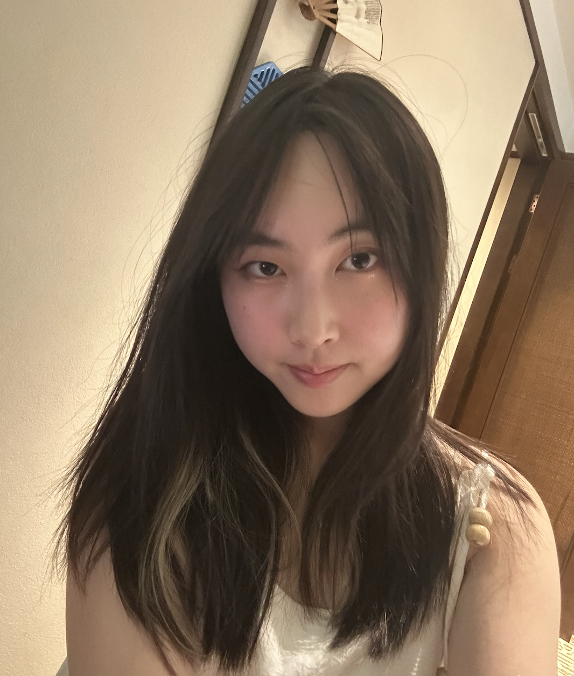
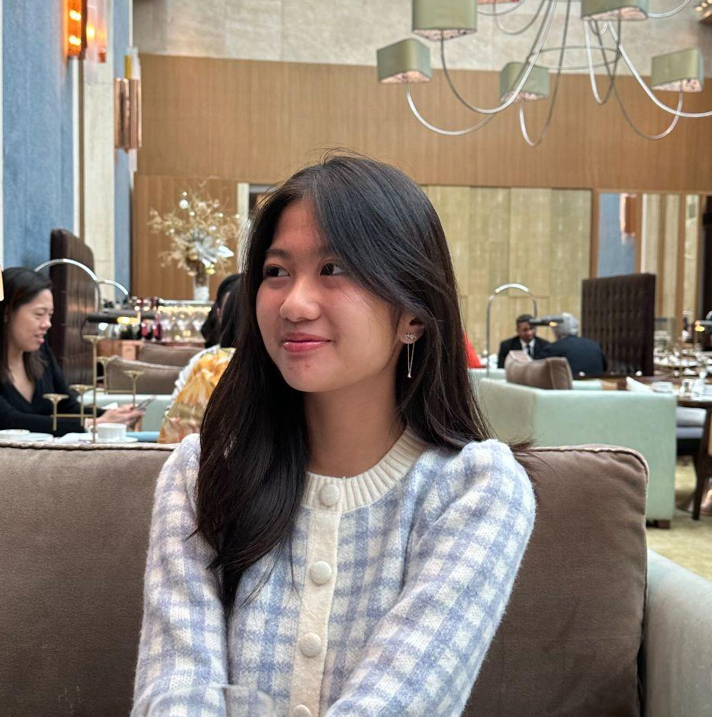
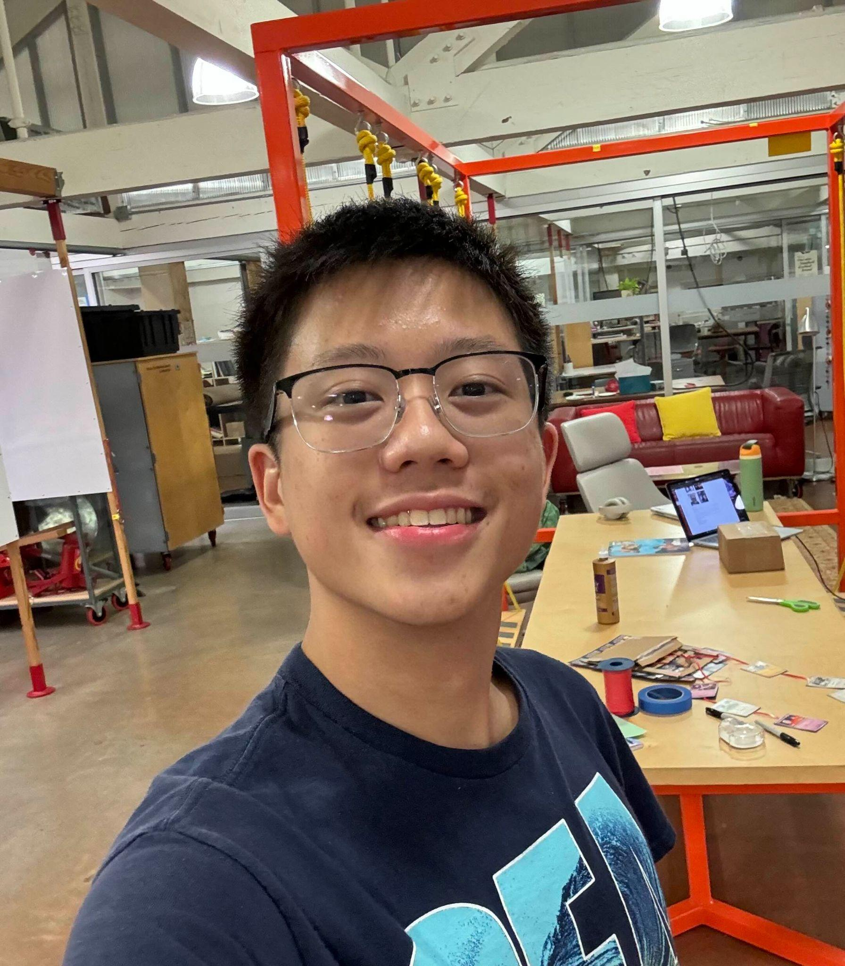
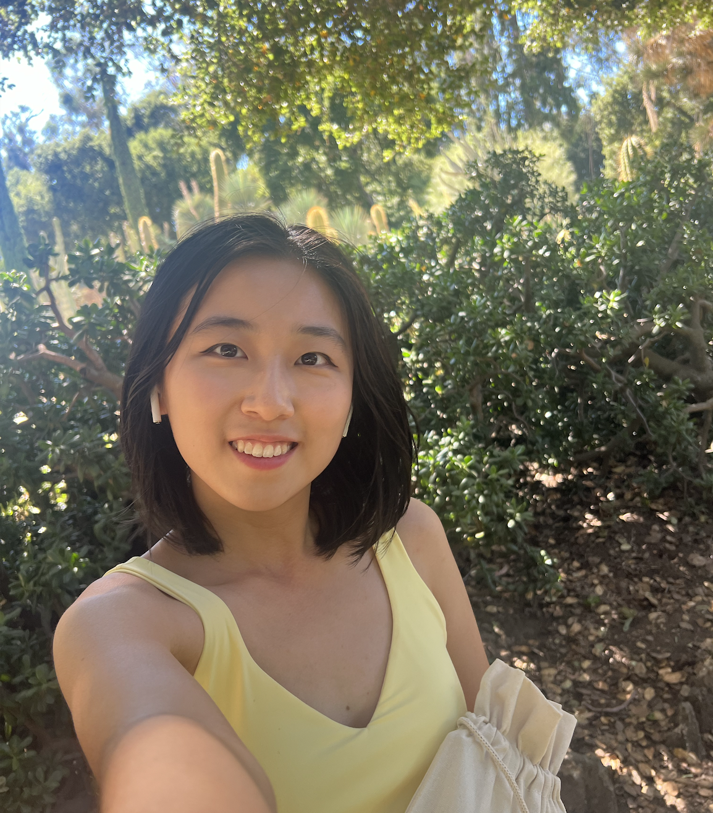
Meet the team!
Kristine Ma
Carolyn Lee
Lucas Wang
Evelyn Song
Junior
Symbolic Systems (HCI)
Junior
Computer Science (HCI)
Sophomore
Design +
CS (HCI)
Junior
Human Biology + CS (HCI)

Slide 4
Project Domain
Burnout + Stress
Looking at how stress impacts college students
Struggles with Time Management
Students often find issues with fitting academic and social time into their schedules
Socializing As Wellness
How can social activity promote mental wellness in college students?

Slide 5

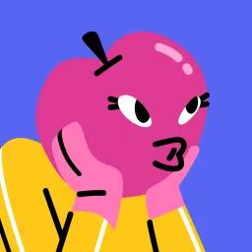
Additional Interviewee Profiles
Daniel D.
Sofia M.
Sophomore at UChicago
Conducted over Zoom (Lucas)
Junior at Stanford University
Conducted at nearby dorm (Carolyn + Kristine)
*Names changed for anonymity*

Slide 6
Daniel D: Study Circle Seeker
“
Main Issues
Lecture based classes made it difficult to make friends
Struggles with time-management
Reaches out to people to form study groups, but they often don’t respond to him
“If I can help it, ... [I’ll invite my friends for] talking, studying, or even a little chat. If I don’t do anything outside with people, I’m going to be dead all day.”
Key Insights
Feels overwhelmed with current commitments and often turns to time-consuming distractions
Sees therapists as professionals, but thinks mental health apps are childish and ineffective
Feels guilty about wasting time and needs external motivation to get things done
Daniel D.
Sophomore at UChicago

Slide 7
Sofia M: An Anxious Achiever
“
Main Issues
Has moments where she feels like she neglects either her social or academic life
Doesn’t have a clear “mechanism” for coping with her stress and often tries to solve everything by herself
I think a lot of people, including myself, feel guilt over not being productive and having social moments.
Key Insights
Is putting more effort into reaching out to friends even though they live farther away
Social events and hangouts tend to be more spontaneous, so it’s hard to predict
Internally hard to feel like she’s on top of her school work
Sofia M.
Junior at Stanford

Slide 8
Interviewee Insights
Anxious
Lonely
Stuck
Guilt
Unsupported
Skeptical
Unmotivated
Concerned
Disconnected

Slide 9
POVs + HMWs

Slide 10
POV #1 : Daniel D.
We met…
Daniel, an undeclared student at the University of Chicago who wants to find more external motivation to be productive.
We were surprised to notice...
that he prefers working in groups, but often ends up working on his own.
We wonder if this means...
he is anxious to create / join study groups to meet up and complete work together.
It would be game changing...
if he could reduce anxiety in forming or finding these groups.

Slide 11
POV #1 : Daniel D.
We met…
Daniel, an undeclared student at the University of Chicago who wants to find more external motivation to be productive.
We were surprised to notice...
that he prefers working in groups, but often ends up working on his own.
We wonder if this means...
he is anxious to create / join study groups to meet up and complete work together.
It would be game changing...
if he could reduce anxiety in forming or finding these groups.

Slide 12
POV #1 : Daniel D.
We met…
Daniel, an undeclared student at the University of Chicago wants to find more external motivation to be productive.
We were surprised to notice...
that he prefers working in groups, but often ends up working on his own.
We wonder if this means...
he is anxious to create / join study groups to meet up and complete work together.
It would be game changing...
if he could reduce anxiety in forming or finding these groups.

Slide 13
POV #1 : Daniel D.
We met…
Daniel, an undeclared student at the University of Chicago wants to find more external motivation to be productive.
We were surprised to notice...
that he prefers working in groups, but often ends up working on his own.
We wonder if this means...
he is anxious to create / join study groups to meet up and complete work together.
It would be game changing...
if he could reduce anxiety in forming or finding these groups.

Slide 14
POV #2 : Sofia M.
We met…
Sofia, a junior majoring in political science at Stanford University who occasionally struggles with planning academics and social events.
We were surprised to notice...
she feels guilt and the need to punish herself for prioritizing social life over academics
We wonder if this means...
she feels like she should choose between her social life and academics.
It would be game changing...
if she could eliminate the guilt she feels after a social hangout.

Slide 15
POV #2 : Sofia M.
We met…
Sofia, a junior majoring in political science at Stanford University who occasionally struggles with planning academics and social events.
We were surprised to notice...
she feels guilt and the need to punish herself for prioritizing social life over academics
We wonder if this means...
she feels like she should choose between her social life and academics.
It would be game changing...
if she could eliminate the guilt she feels after a social hangout.

Slide 16
POV #2 : Sofia M.
We met…
Sofia, a junior majoring in political science at Stanford University who occasionally struggles with planning academics and social events.
We were surprised to notice...
she feels guilt and the need to punish herself for prioritizing social life over academics
We wonder if this means...
she feels like she should choose between her social life and academics.
It would be game changing...
if she could eliminate the guilt she feels after a social hangout.

Slide 17
POV #2 : Sofia M.
We met…
Sofia, a junior majoring in political science at Stanford University who occasionally struggles with planning academics and social events.
We were surprised to notice...
she feels guilt and the need to punish herself for prioritizing social life over academics
We wonder if this means...
she feels like she should choose between her social life and academics.
It would be game changing...
if she could eliminate the guilt she feels after a social hangout.

Slide 18
POV #3 : Grace J.
We met…
Grace, an ambitious international junior at UPenn studying engineering and business.
We were surprised to notice...
despite her willingness to reach out and social events offered by the school, Grace doesn’t feel like she has a close group of friends, and that most friends disappear after a while.
We wonder if this means...
college students need more support to maintain their existing / prior friend groups.
It would be game changing...
to enable students to make more friends while maintaining good connections with their existing friends.

Slide 19
POV #3 : Grace J.
We met…
Grace, an ambitious international junior at UPenn studying engineering and business.
We were surprised to notice...
despite her willingness to reach out and go to social events offered by the school, Grace doesn’t feel like she has a close group of friends, and that most friends disappear after a while.
We wonder if this means...
college students need more support to maintain their existing / prior friend groups.
It would be game changing...
to enable students to make more friends while maintaining good connections with their existing friends.

Slide 20
POV #3 : Grace J.
We met…
Grace, an ambitious international junior at UPenn studying engineering and business.
We were surprised to notice...
despite her willingness to reach out and go to social events offered by the school, Grace doesn’t feel like she has a close group of friends, and that most friends disappear after a while.
We wonder if this means...
college students need more support to maintain their existing / prior friend groups.
It would be game changing...
to enable students to make more friends while maintaining good connections with their existing friends.

Slide 21
POV #3 : Grace J.
We met…
Grace, an ambitious international junior at UPenn studying engineering and business.
We were surprised to notice...
despite her willingness to reach out and social events offered by the school, Grace doesn’t feel like she has a close group of friends, and that most friends disappear after a while.
We wonder if this means...
college students need more support to maintain their existing / prior friend groups.
It would be game changing...
to enable students to make more friends while maintaining good connections with their existing friends.

Slide 22
POV Takeaways
1.
2.
3.
Importance of Social Bonds
🤝
Need for work-life balance
⚖️
Negative emotions surrounding social planning
❌

Slide 23
Top 3 HMWs
POV #2
POV #1
POV #3
HMW make social hangouts feel productive?
HMW make scheduling feel less confrontational?
HMW turn weak ties (from classes) into strong ties?

Slide 24
Top 3 Solutions
HMW #2
HMW #2
HMW #3
Create a platform that allows people to alert/notify each other by setting statuses when they are free, lonely, etc.
A platform where friends in a group get responsibility to plan an event (the responsibility rotates per week/biweekly).
Tinder-style app where you can swipe right on people you want to be better friends with (match people w/ mutual interest!)

Slide 25
Experience Prototype 1.
Solution: Notifying friend groups through emotion and activity statuses
Assumption:
Prototype Description:
People are willing to share and update their emotional status or what they’re currently doing at the moment.
We created a group chat of people in an existing friend group and asked them to text their emotional status and any activities they were willing to share throughout the day. At the end of the day, we asked participants to reflect on the experience to gauge their comfort levels and enthusiasm for continuing this type of experience.

Slide 26
Experience Prototype 1.
Solution: Notifying friend groups through emotion and activity statuses
Assumption:
Prototype Description:
People are willing to share and update their emotional status or what they’re currently doing at the moment.
We created a group chat of people in an existing friend group and asked them to text their emotional status and any activities they were willing to share throughout the day. At the end of the day, we asked participants to reflect on the experience to gauge their comfort levels and enthusiasm for continuing this type of experience.

Slide 27
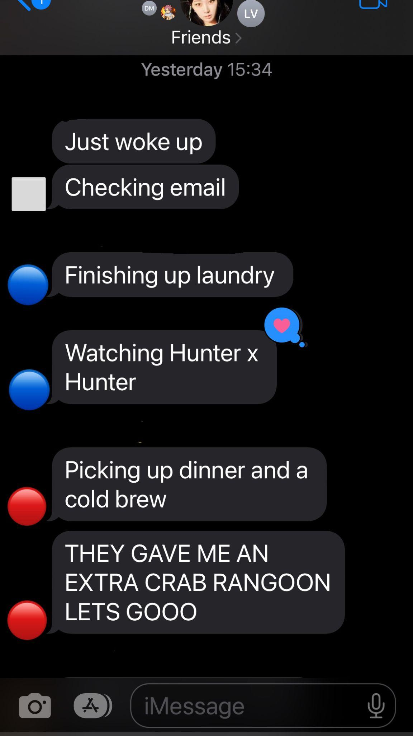
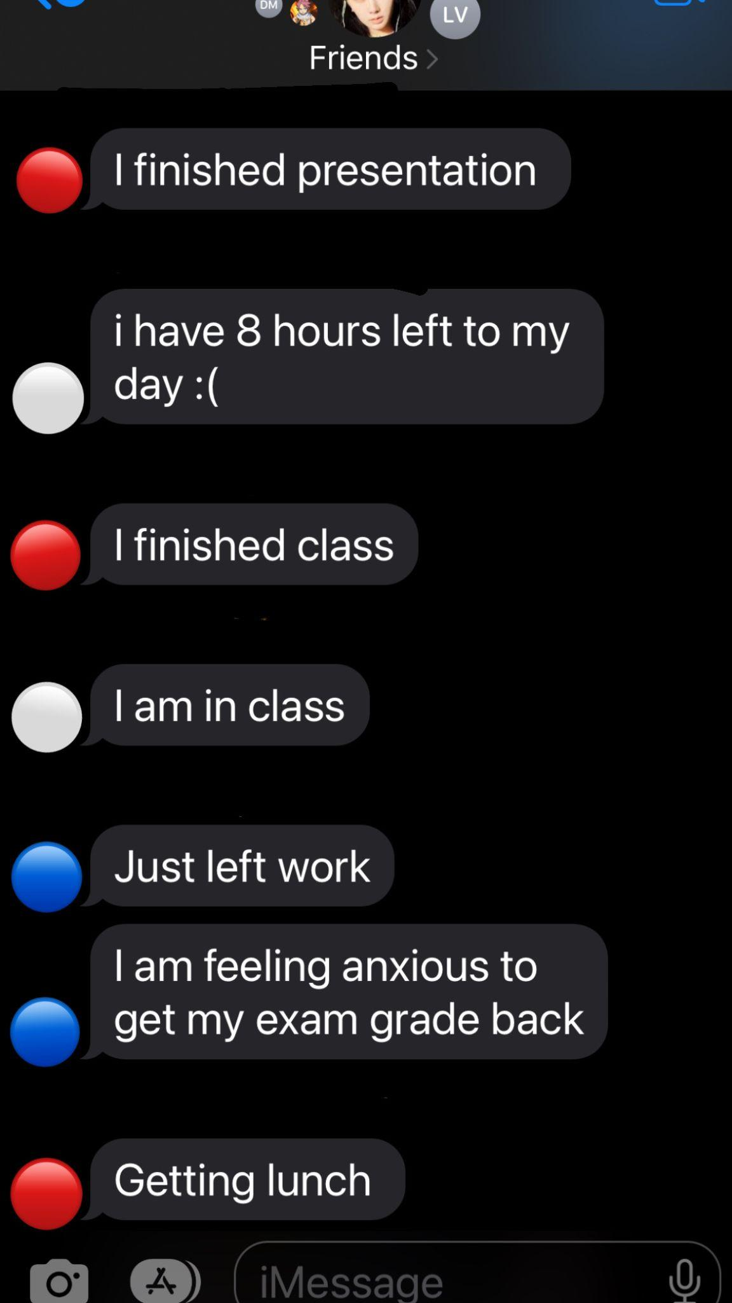
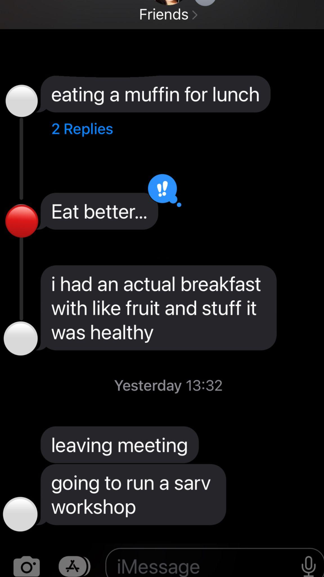
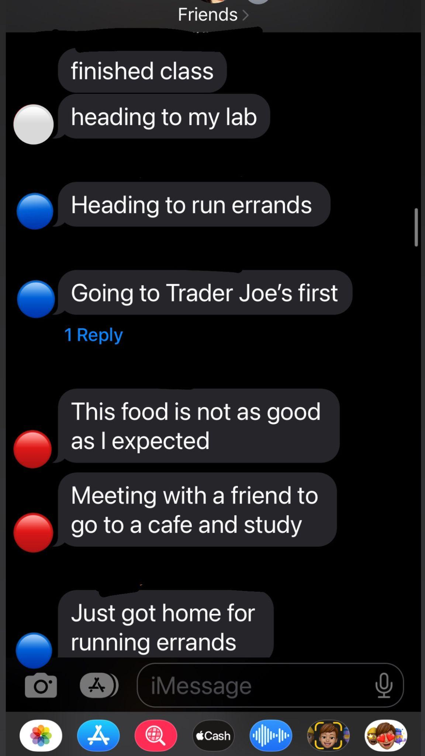
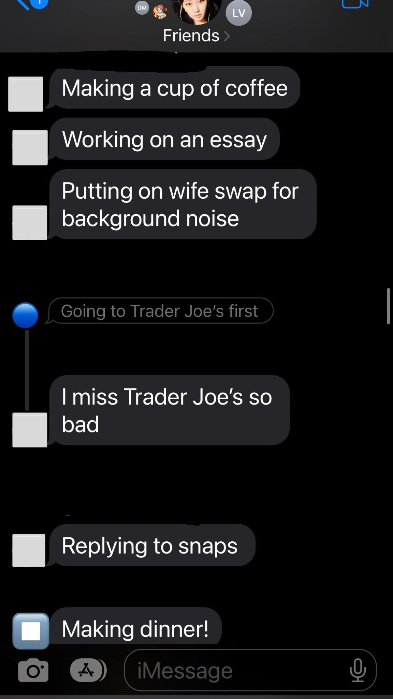
Experience Prototype 1.

Slide 28
Results
Participants:
Group 1: 3 friends from UMich, recruited through Kristine
Group 2: Junior from Northwestern recruited through Evelyn
What Worked:
What Didn’t Work:
Users were consistently updating on emotions and activities, no matter how mundane
General comfort in updating their life
Wide variety of things shared throughout the updates
Some users felt like it was interesting but not much of a benefit
Users didn’t like having to remember sending updates throughout the day
Not many “strong emotions” were shared
Felt too awkward sharing trivial things
→ Assumption was valid as all participants were willing to share a variety of updates

Slide 29
Experience Prototype 2.
Solution: Rotating roles for social planning in friend groups
Assumption:
Prototype Description:
People see scheduling as a something they have to go out of their way for.
People in an existing group of friends were instructed to fill out a when2meet to find available times. Then, each participant was instructed to create an event idea, given the names of the other friends in the friend group and a weekday/time. Once all members have planned an event, they were the given the event dates and times scheduled over the next three weeks, each being led by one host.

Slide 30
Experience Prototype 2.
Solution: Rotating roles for social planning in friend groups
Assumption:
Prototype Description:
People see scheduling as a something they have to go out of their way for.
People in an existing group of friends were instructed to fill out a when2meet to find available times. Then, each participant was instructed to create an event idea, given the names of the other friends in the friend group and a weekday/time. Once all members have planned an event, they were the given the event dates and times scheduled over the next three weeks, each being led by one host.

Slide 31
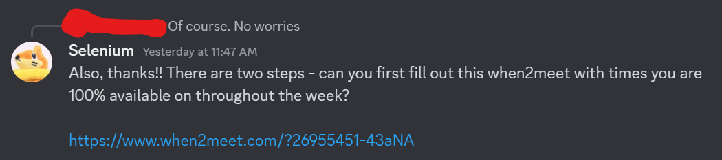
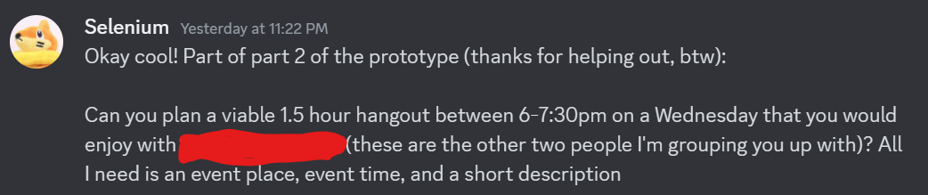
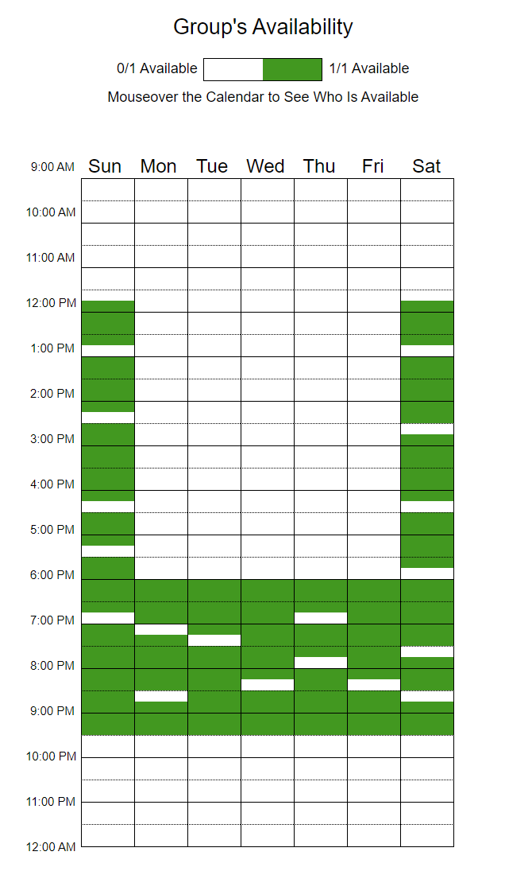
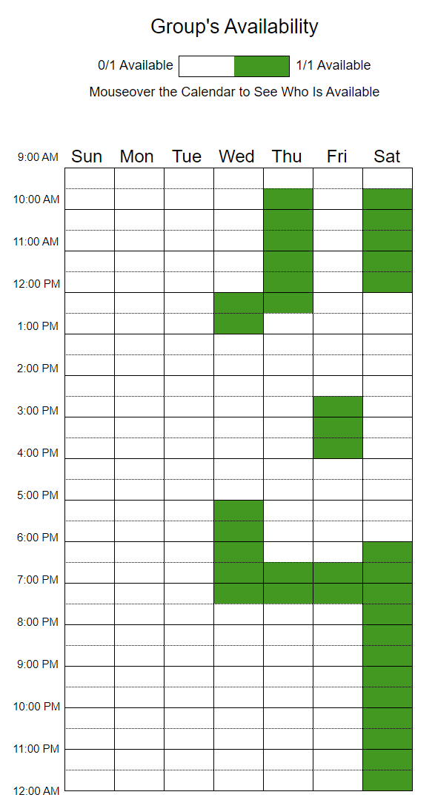
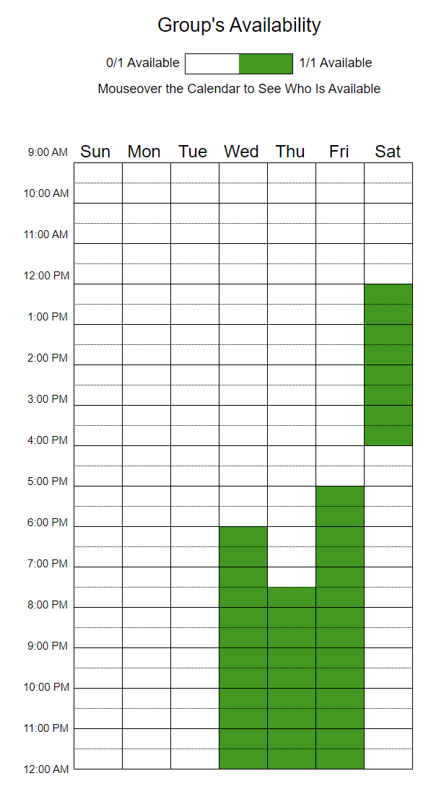
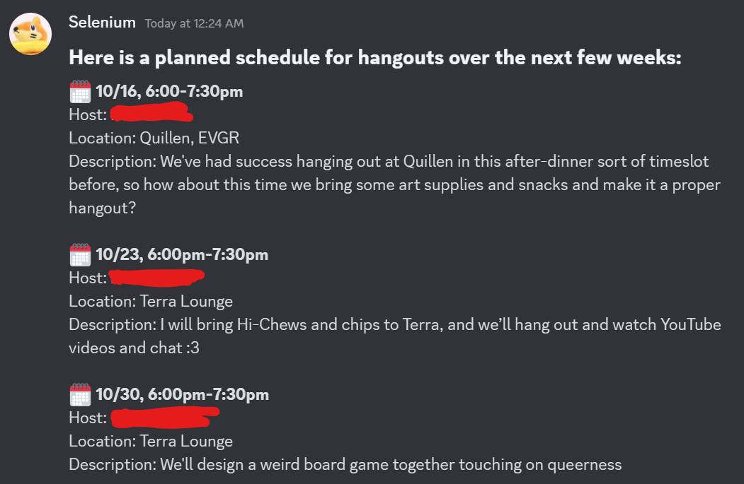
Experience Prototype 2.

Slide 32
Results
Participants:
3 friends from Stanford, recruited through Lucas
Recruited due to their need for better social planning methods
What Worked:
What Didn’t Work:
All social events planned fit perfectly into all participants schedules
The activities planned were enjoyable
Participants felt like it was low effort and rewarding
Notifications to remind participants to plan events were helpful
Some participants were confused by the initial setup
There was no second iteration to help participants plan if a certain person couldn’t make it
→ Assumption was not valid as all participants noted the ease of this experience prototype which implies strong potential for this solution

Slide 33
Experience Prototype 3.
Solution: Matching acquaintances to develop friendships through swiping mechanic
Assumption:
Prototype Description:
People want to reconnect with former friends or acquaintances through a quick method.
Recruit one person and have them go through a list of people from their freshman dorm. The list of people was uploaded to Quizlet to make use of the swipe left/right feature and simulate our solution idea. The participant should swipe right if they are interested in getting to know the person better. After the process, interview them to understand their experience.

Slide 34
Experience Prototype 3.
Solution: Matching acquaintances to develop friendships through swiping mechanic
Assumption:
Prototype Description:
People want to reconnect with former friends or acquaintances through a quick method.
Recruit one person and have them go through a list of people from their freshman dorm. The list of people was uploaded to Quizlet to make use of the swipe left/right feature and simulate our solution idea. The participant should swipe right if they are interested in getting to know the person better. After the process, interview them to understand their experience.

Slide 35
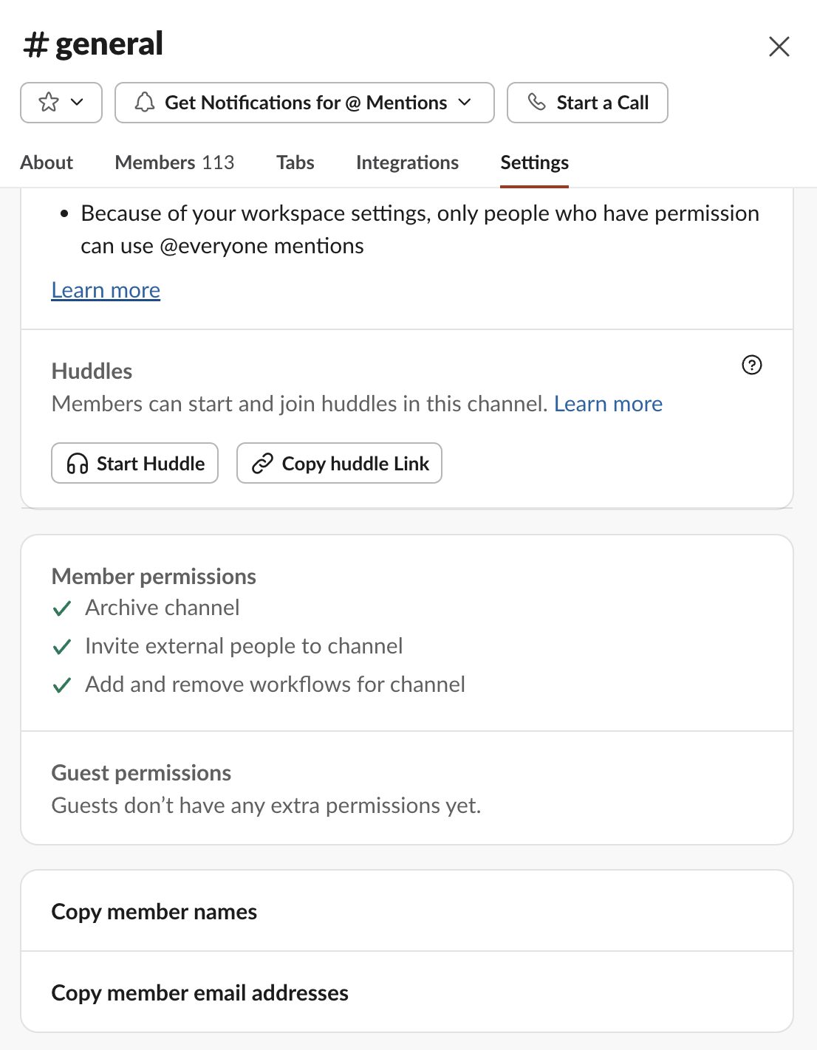
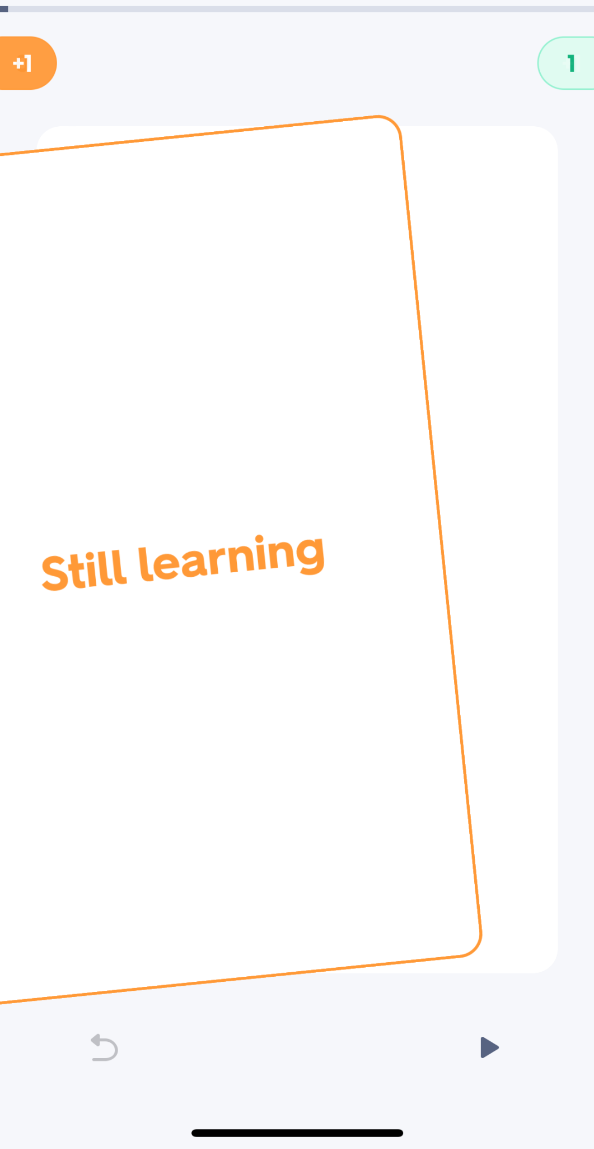
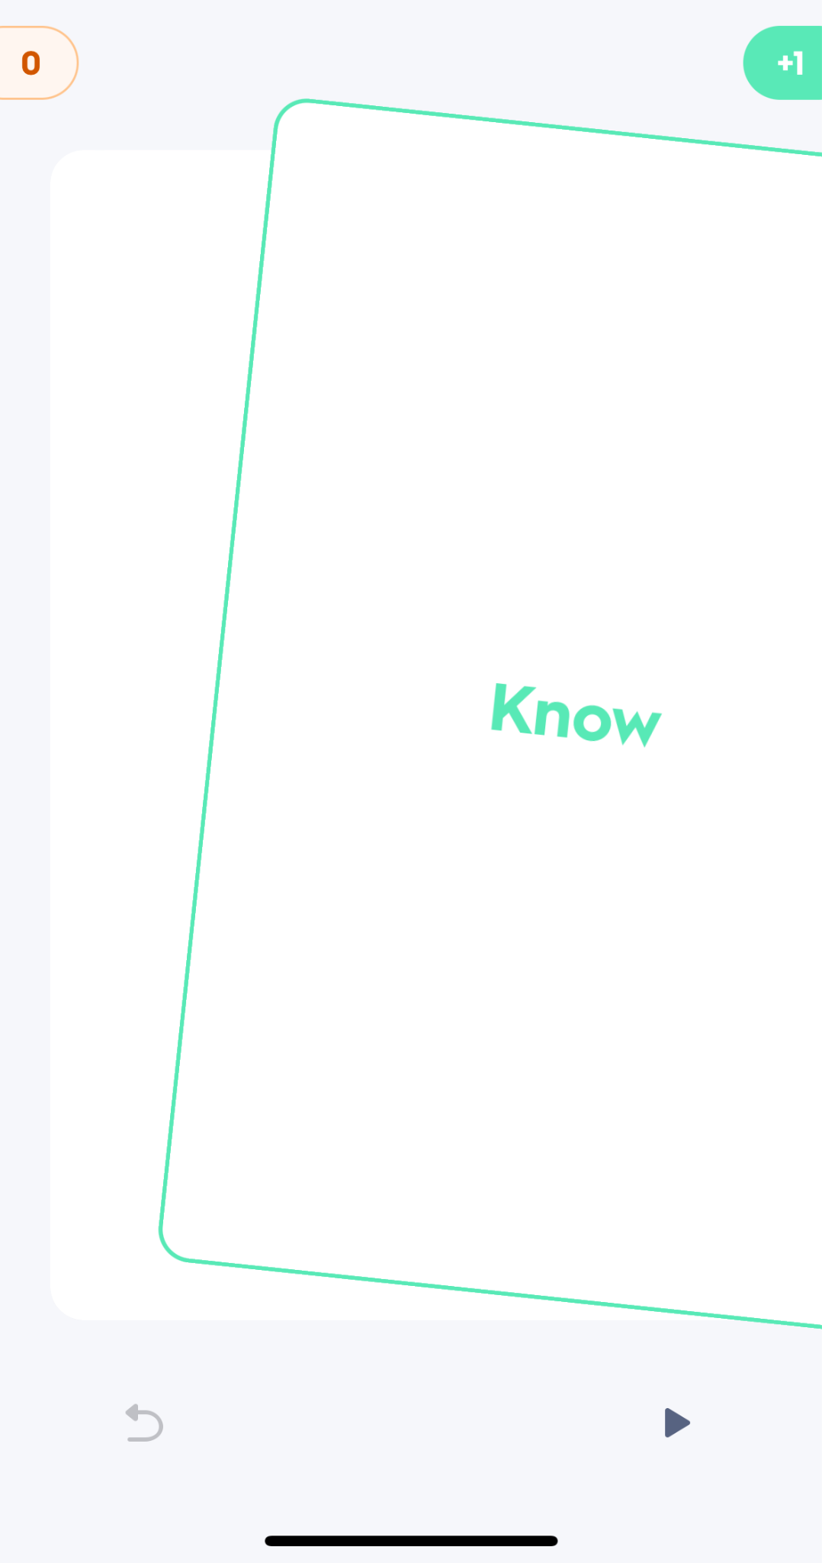
Experience Prototype 3.

Slide 36
Results
Participants:
Former frosh dormmate, recruited through Carolyn
Recruited since they expressed interest in reconnecting with people
What Worked:
What Didn’t Work:
Noted that the swipe function made it simple to sort
Remembered a majority of people from his freshman dorm
Participant got bored by the 10th name, noted that he stopped thinking too much about the prompt
Participant stated “I don’t actually think I wanted to reconnect with 40 people, maybe only 15”
Seemed counterproductive to “automate” the process
→ Assumption was partially valid as there were a good number of people on the “reconnect” list, but the user pointed out many flaws in the overall experience

Slide 37
What’s Next?
Chosen Solution(s):
Solutions 1 and 2 show the most promise with the experience prototype results
More positive feedback and outcomes compared to solution 3, which felt too “automated”
Solution 3 also was said to “already exist”
A combination of status updates and scheduling could alleviate the stress for students to plan events and stay connected with friends
Ethical Implications:
Both chosen solutions require a level of honesty from the user, especially in regards to talking about feelings which could cause privacy concerns
Users might get emotionally dependent on relying on others to respond to their status
There may be a social pressure on users to update constantly, or plan even if things get busy

Slide 38
Target Users
Who does it serve?
Who does it leave out?
Students in existing friend groups hoping to maintain connections
People who get stressed due to planning social events with others
Those who face difficulties reaching out to friends
People who are looking for new friends or have trouble meeting new people
People with highly fluctuating availabilities
People who prefer one-on-one social activities

Slide 39
Appendix

Slide 40
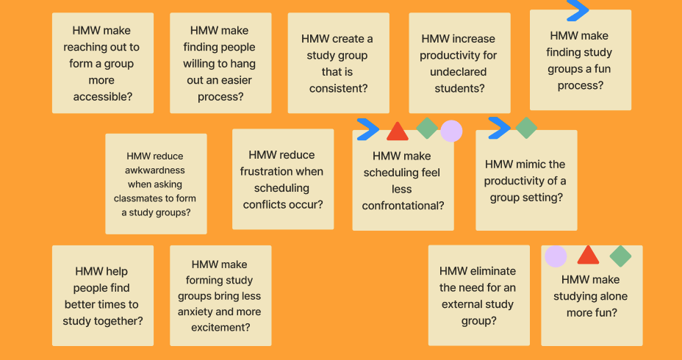
HMW: Daniel D.

Slide 41
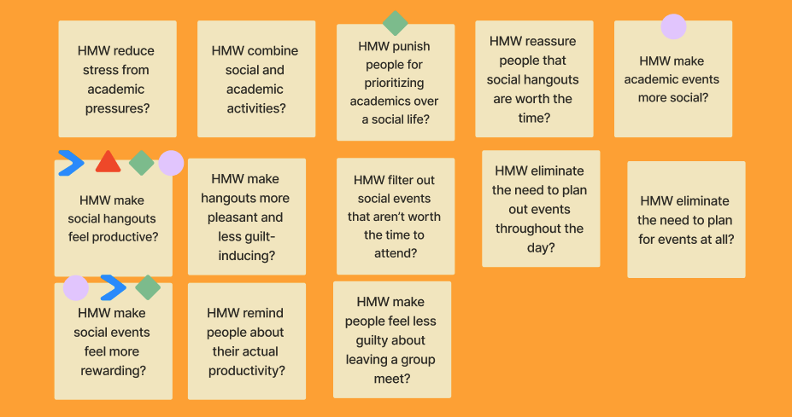
HMW: Sofia M.

Slide 42
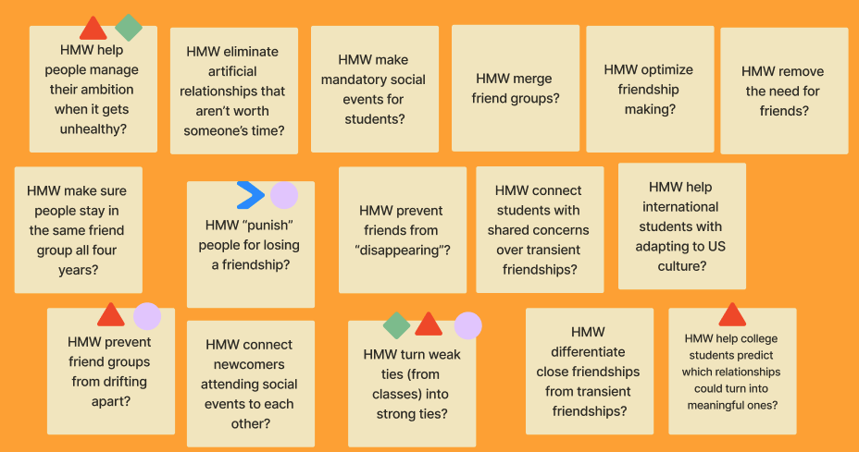
HMW: Grace J.

Slide 43
HMW: Grace J.

Slide 44
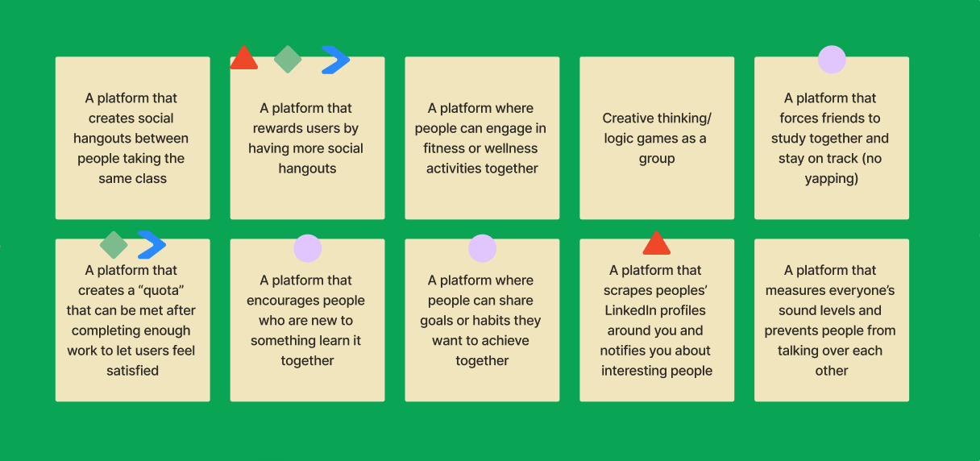
Solutions: HMW #1

Slide 45
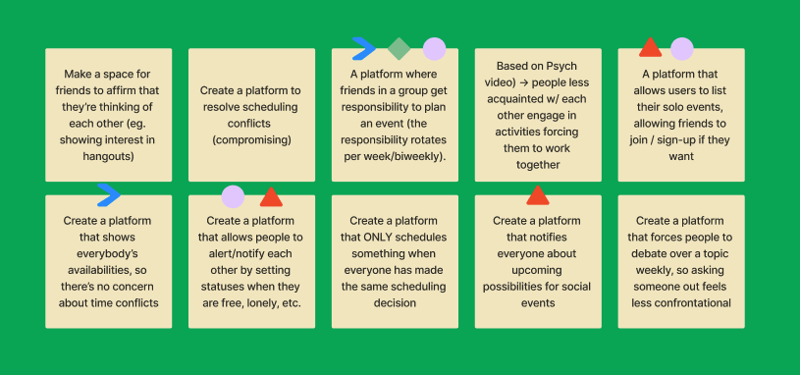
Solutions: HMW #2

Slide 46
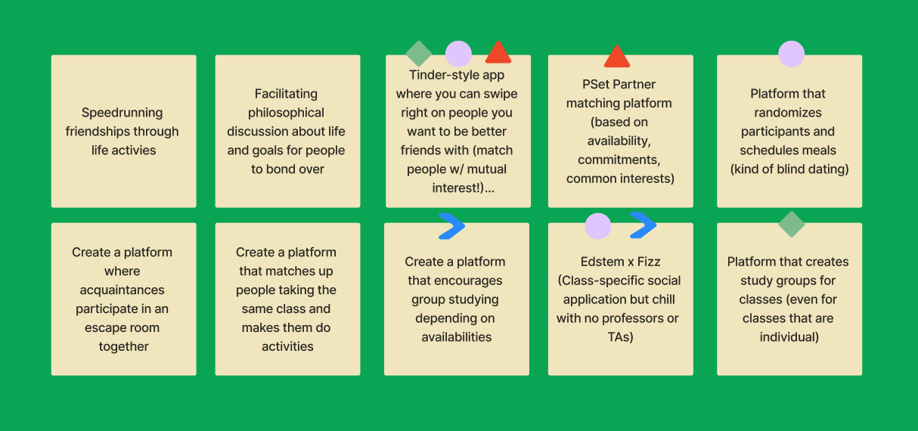
Solutions: HMW #3

Slide 47
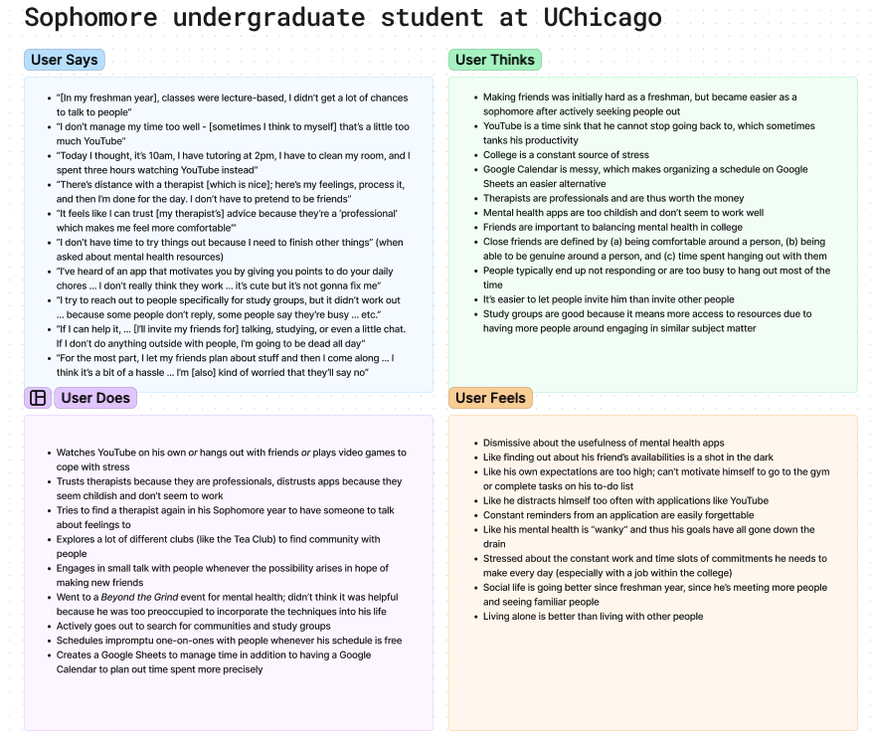
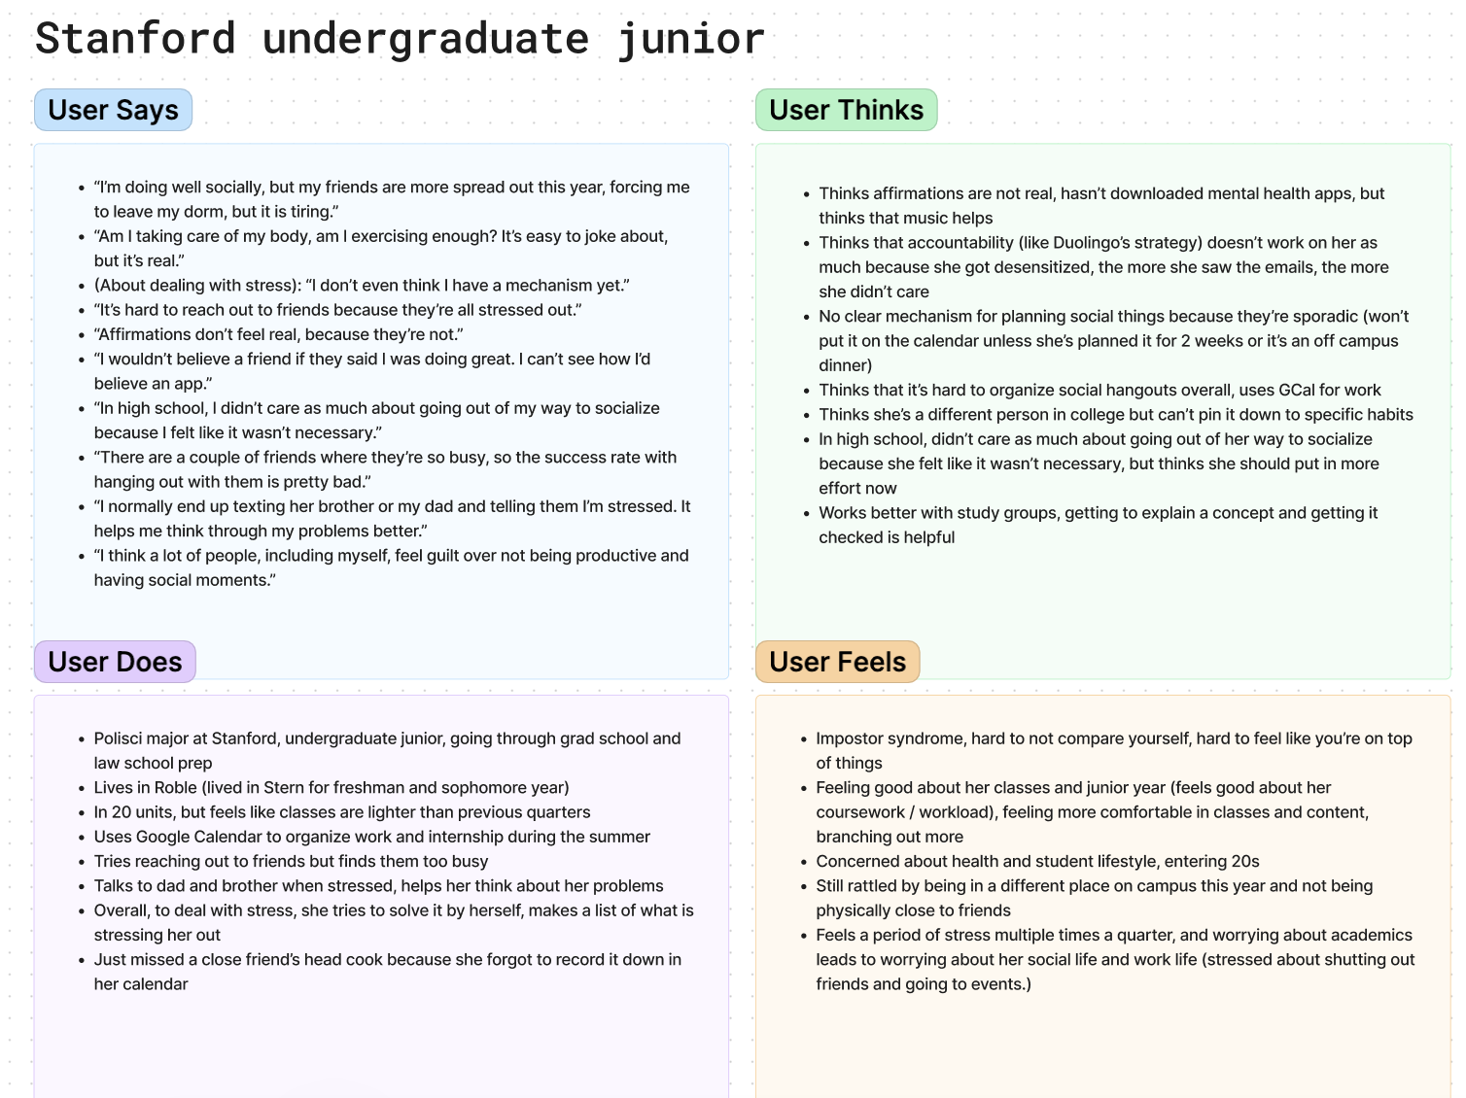
Empathy Maps
Link: https://www.figma.com/board/CzkD5IEsZpkGwa3ZxWLMfR/CS147-Empathy-Maps?node-id=0-1&node-type=canvas&t=Y0iudQ2q3qSiMXGm-0

Slide 48
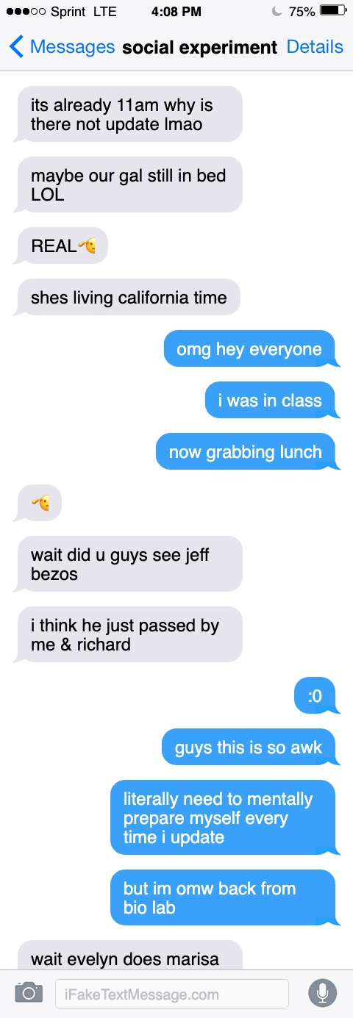
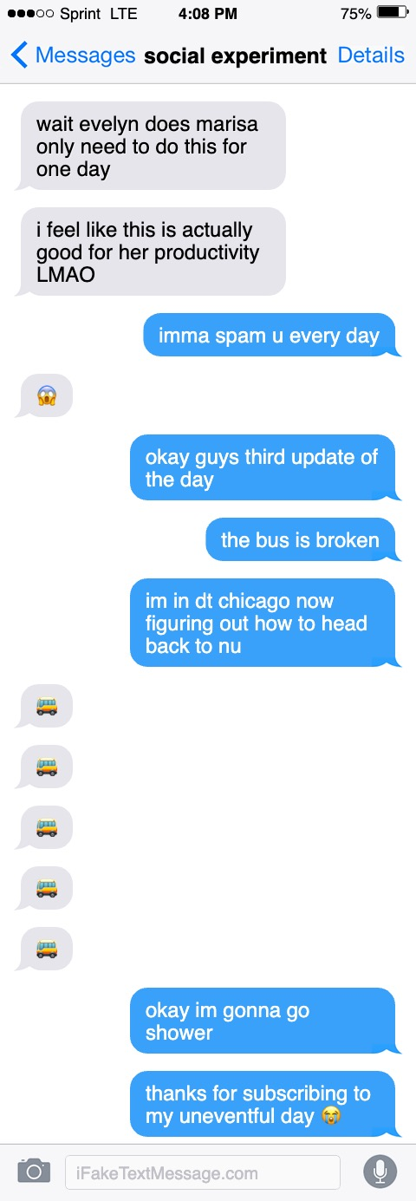
Experience Prototype 1 - Northwestern Student
1. What did you like about this experience
2. What did you not like about this experience
3. What were some barriers to updating your status in the gc?
4. Did this experience benefit you in any way?
5. What categories are you comfortable updating? What about emotions such as loneliness, happiness?
1. I guess I get to bond with my friends a little more and I work a bit more efficient
2. Too awkward still. Updating trivial stuff that has nothing to do with my friends. Feels like I am constantly disturbing others and seeking attention… especially in front of a group of people who aren’t familiar with each other
3. I don’t like updating life routine, feels like I am a robot. If I think it’s unnecessary.. Sending message from time to time is really annoying, especially just random messages
4. Feel more obligated to complete my tasks since I am reporting it to more people?
5. Like generally interesting stuff (gossip, new experiences, emotions, thoughts, new discoveries, travel, fun, entertainment…

Slide 49
Experience Prototype 1 - UMich Student 1
1. What did you like about this experience
2. What did you not like about this experience
3. What were some barriers to updating your status in the gc?
4. Did this experience benefit you in any way?
5. What categories are you comfortable updating? What about emotions such as loneliness, happiness?
1. It was fun to see status updates of people throughout the day.
2. Didn’t like having to remember to send them though
3. My forgetfulness
4. I wouldn’t say it benefited me in any way particularly
5. Just uploaded what I was doing which was fine

Slide 50
Experience Prototype 1 - UMich Student 2
1. What did you like about this experience
2. What did you not like about this experience
3. What were some barriers to updating your status in the gc?
4. Did this experience benefit you in any way?
5. What categories are you comfortable updating? What about emotions such as loneliness, happiness?
1. I liked seeing what people were doing cause sometimes I’m on my phone like… there is nothing to see but
then I got a like “drunk” from [Friend] and that’s funny asf
2. Phone usage drained my battery faster than normal
3. Classes, Memory of task, Phone dying
4. Not particularly
5. No emotions other than expressing distaste for a very salty noodle dish for lunch

Slide 51
Experience Prototype 1 - UMich Student 3
1. What did you like about this experience
2. What did you not like about this experience
3. What were some barriers to updating your status in the gc?
4. Did this experience benefit you in any way?
5. What categories are you comfortable updating? What about emotions such as loneliness, happiness?
1. I liked that there was a wide variety of things shared through status updates
2. I don’t really have anything negative to say I guess maybe what [Friend] said about forgetting to update y’all on what I was doing
3. I didn’t really realize this was happening until like halfway through the day (my own fault)
4. I thought it was interesting but I don’t really know if that’s a benefit
5. I didn’t really have anything crazy to share today it was kind of a boring day for me

Slide 52
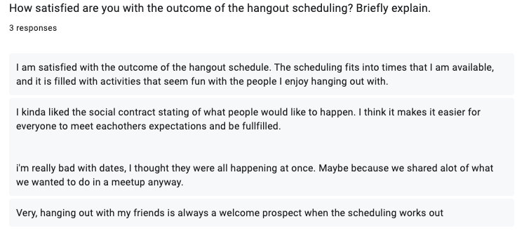
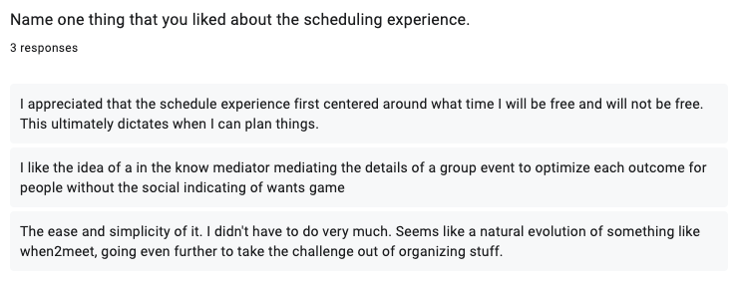
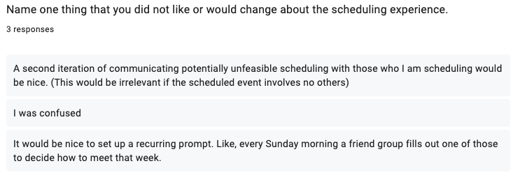
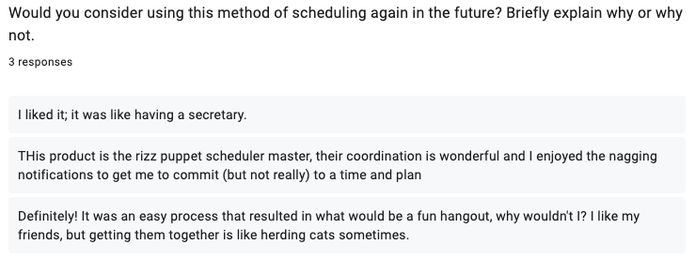
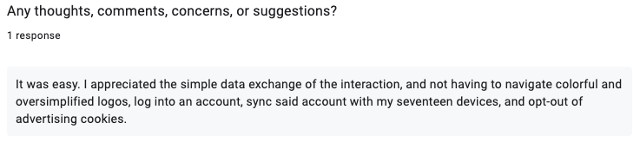
Experience Prototype 2 - Feedback

